Slide 1
Discrete Structures
1. Set Basics
Objective
to re-introduce basic set ideas, set operations, set identities

Slide 2
1. What are Sets?
A set is an unordered collection of things, with no duplicates allowed
e.g. the students in this class
b ∈A
(b is a member
or element
of the set A)
A
a
b
x ∉A
(x is not a member
of the set A)
m
h
t

Slide 3
Examples
Set of all vowels in the English alphabet:
V = {a,e,i,o,u}
Set of all odd positive integers less than 10:
O = {1,3,5,7,9}
Set of all positive integers less than 100:
S = {1,2,3,…….., 99}
Set of all integers less than 0:
S = {…., -3,-2,-1}

Slide 5
Set-Builder Notation
Specify the property (or properties) that all members must satisfy:
S = {x | x is a positive integer less than 100}
O = {x ∈ Z⁺ | x is odd and x < 10} // {1,3,5,7,9}
A predicate (boolean function) can be used:
S = {x | P(x)}
Example: S = {x | isPrime(x)}

Slide 6
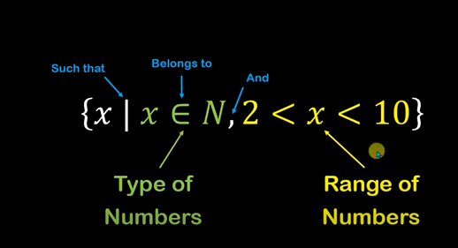

Slide 7
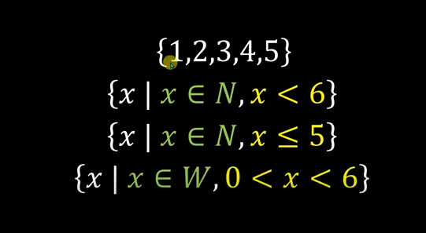

Slide 8
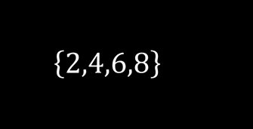
Set-Builder Notation?

Slide 9
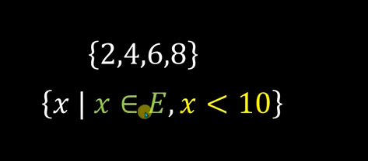

Slide 10
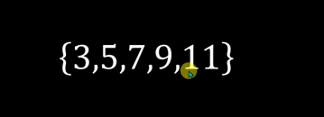
Set-Builder Notation??

Slide 11
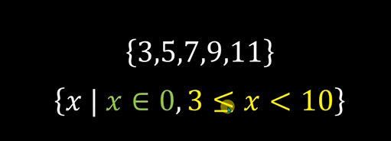

Slide 12
Interval Notation
[a,b] = {x | a ≤ x ≤ b} e.g. [0, 5] = { 0,1, 2, 3, 4,5}
[a,b) = {x | a ≤ x < b} e.g. [0, 5) = {0, 1, 2, 3, 4}
A bit like array indicies in C,
e.g. A[5]
(a,b] = {x | a < x ≤ b} e.g. (0, 5] = { 1, 2, 3, 4,5}
(a,b) = {x | a < x < b} e.g. (0, 5) = { 1, 2, 3, 4}
Closed interval: [a,b] that has limit points
Open interval: (a,b) interval has no end points

Slide 13
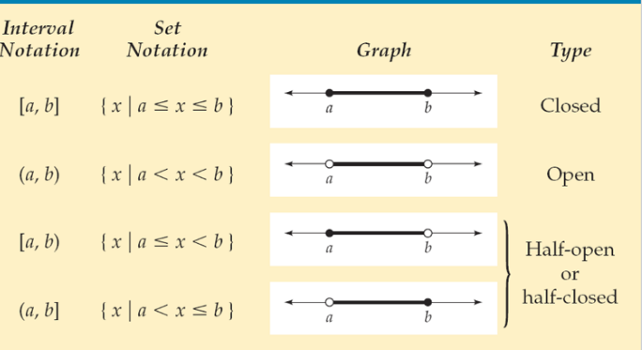

Slide 14
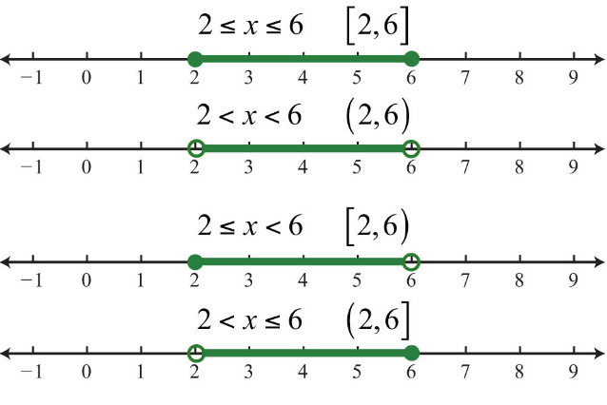

Slide 15
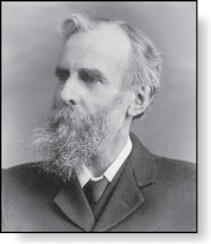
Universal Set and Empty Set
The universal set U contains everything in the domain.
The empty set has no elements; written as ∅, or {}
U
c
g
b
...
a e i
o u
d
f
Venn Diagram
(the domain is the
small letters)
John Venn (1834-1923)

Slide 16
Sets in Sets
Sets can be elements of sets.
{{1,2,3}, a, {b,c }}
{N,Z,Q,R}
The empty set is different from a set containing the empty set.
∅ ≠ { ∅ }
b c
1 2 3
a
≠
empty set

Slide 17
Set Cardinality (size, | | )
The cardinality of a set A, |A|, is the number of elements in A.
Examples:
|ø| = 0
|{1,2,3}| = 3
|{ø}| = 1
The set of integers is infinite in size.

Slide 18
Subset (⊆)
The set A is a subset of B, iff every element of A is also an element of B.
A ⊆ B means that A is a subset of the set B
A is smaller (or the same size) as B
Example: A = {jim, ben }, B = {jim, ben, andrew}
A
jim
andrew
ben
B

Slide 19
Proper Subset (⊂)
If A ⊆ B, but A ≠B, then A is a proper subset of B
written as A ⊂ B
A is smaller than B

Slide 20
What are Proper Subsets?
Set A is considered to be a proper subset of Set B if Set B contains at least one element that is not present in Set A.
Example: If set A has elements as {12, 24} and set B has elements as {12, 24, 36}, then set A is the proper subset of B because 36 is not present in the set A.

Slide 21
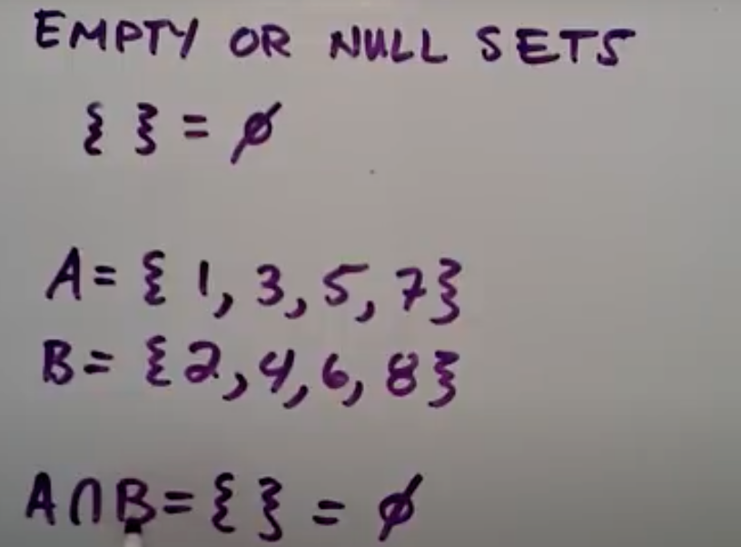
Empty Set/NULL SET
The empty set is the unique set having no elements; its size or cardinality (count of elements in a set) is zero
{}= ∅

Slide 22
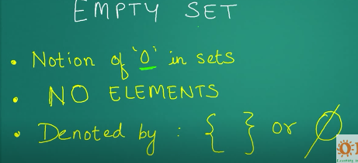

Slide 23
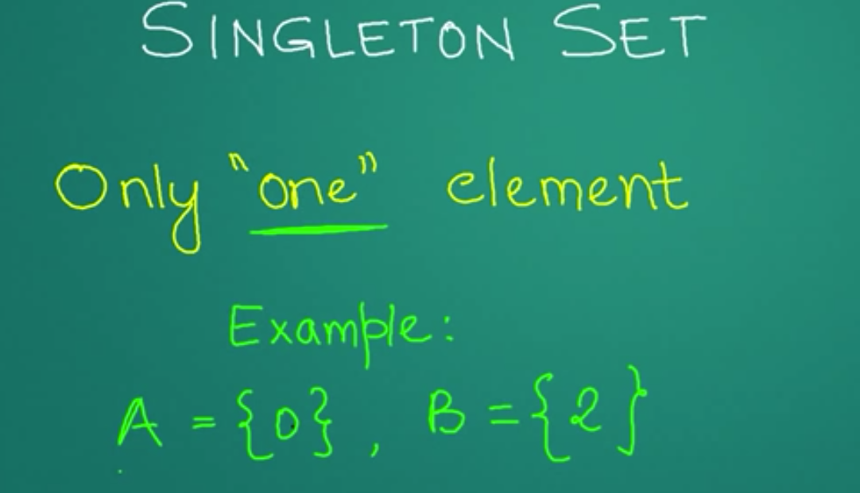
Singleton Set

Slide 24
2. Set Operations
Union
Intersection
Complement
Difference
Cardinality of Union

Slide 25
Union (∪)
The union of the sets A and B is A ∪ B
Example: What is {1,2,3} ∪ {3, 4, 5}?
Solution: {1,2,3,4,5}
U
A
B
A ∪ B

Slide 26
Intersection (∩)
The intersection of sets A and B is A ∩ B
If the intersection is empty, then A and B are called disjoint.
Example: What is? {1,2,3} ∩ {3,4,5} ? {3}
Example: What is {1,2,3} ∩ {4,5,6} ?
Solution: ∅ (disjoint)
U
A
B
A ∩B

Slide 27
Complement (not)
The complement of the set A (with respect to U), is Ā, which is the set U - A
It is also written as A^{c}
Example: If U is the positive integers less than 10, what is the complement of {x | x > 3}
Solution: { 1, 2, 3 }
U
A
Ā

Slide 28
Difference (-)
The difference of the sets A and B is A – B
the set containing the elements of A that are not in B
Also called the complement of B with respect to A.
A – B = A ∩‾B
U
A
B
A − B

Slide 29
The Cardinality of the Union of Two Sets
In mathematics, the cardinality of a set is a measure of the "number of elements of the set".
For example, the set A = {2, 4, 6} contains 3 elements, and therefore A has a cardinality of 3.
|A ∪ B| = |A| + | B| - |A ∩ B|
U
A
B

Slide 30
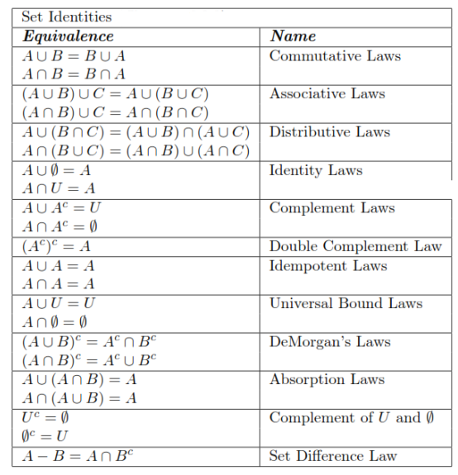
3

Slide 31

One informal way of 'proving' an identity is to draw Venn diagrams for each side of the '=' and show they are the same.
e.g. 2nd De Morgan Law:
A
B
?
A
B
=
U
U

Slide 32
4. More Information
Discrete Mathematics and its Applications Kenneth H. Rosen McGraw Hill, 2007, 7th edition
chapter 2, sections 2.1 – 2.2

Slide 33

Cartesian product
Let A X B be the sets, the Cartesian product of two sets is denoted by A X B.
A X B are the ordered pairs (a,b) where a belongs to A and b belongs to B.

Slide 34
Cartesian Product of sets A and B is defined as the set of all ordered pairs (x, y) such that x belongs to A and y belongs to B. For example, if A = {1, 2} and B = {3, 4, 5}, then the Cartesian Product of A and B is {(1, 3), (1, 4), (1, 5), (2, 3), (2, 4), (2, 5)}.

Slide 35
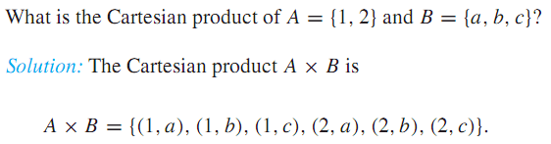
Exercise
Let A is the set of all students at a university
B is the all courses offered in the university. So the cartesian product will be?

Slide 36


Exercise
Show that A X B C

